Slide 1


Finding the Power
Jack Adiletta, Joe Molder, Meghan Lyle, Zack Gluck

Slide 2

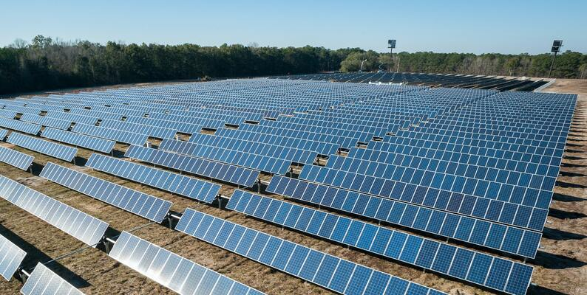
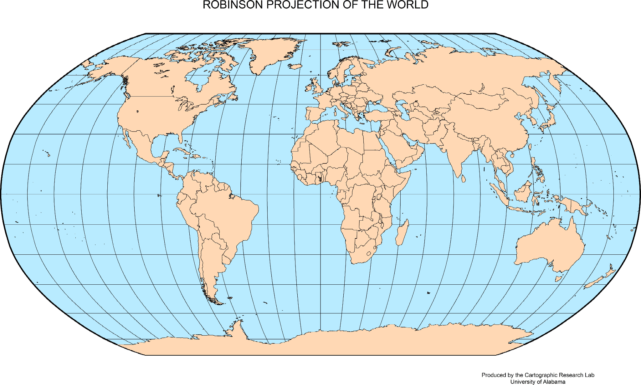
World Emissions Dataset
World Energy Consumption (kaggle.com)
Notes:
Dataset from Kaggle - made from a combination of Energy.org datasets- a reputable source
Dataset contains 129 columns of data pertaining to emissions, energy production, and energy consumption - it is sparse as it is spliced together from source datasets without common features. One dataset containing algeria may contain production data, but another with NATO may not.
We wanted to isolate the individual countries from the other alliances and groupings in the dataset.

Slide 3
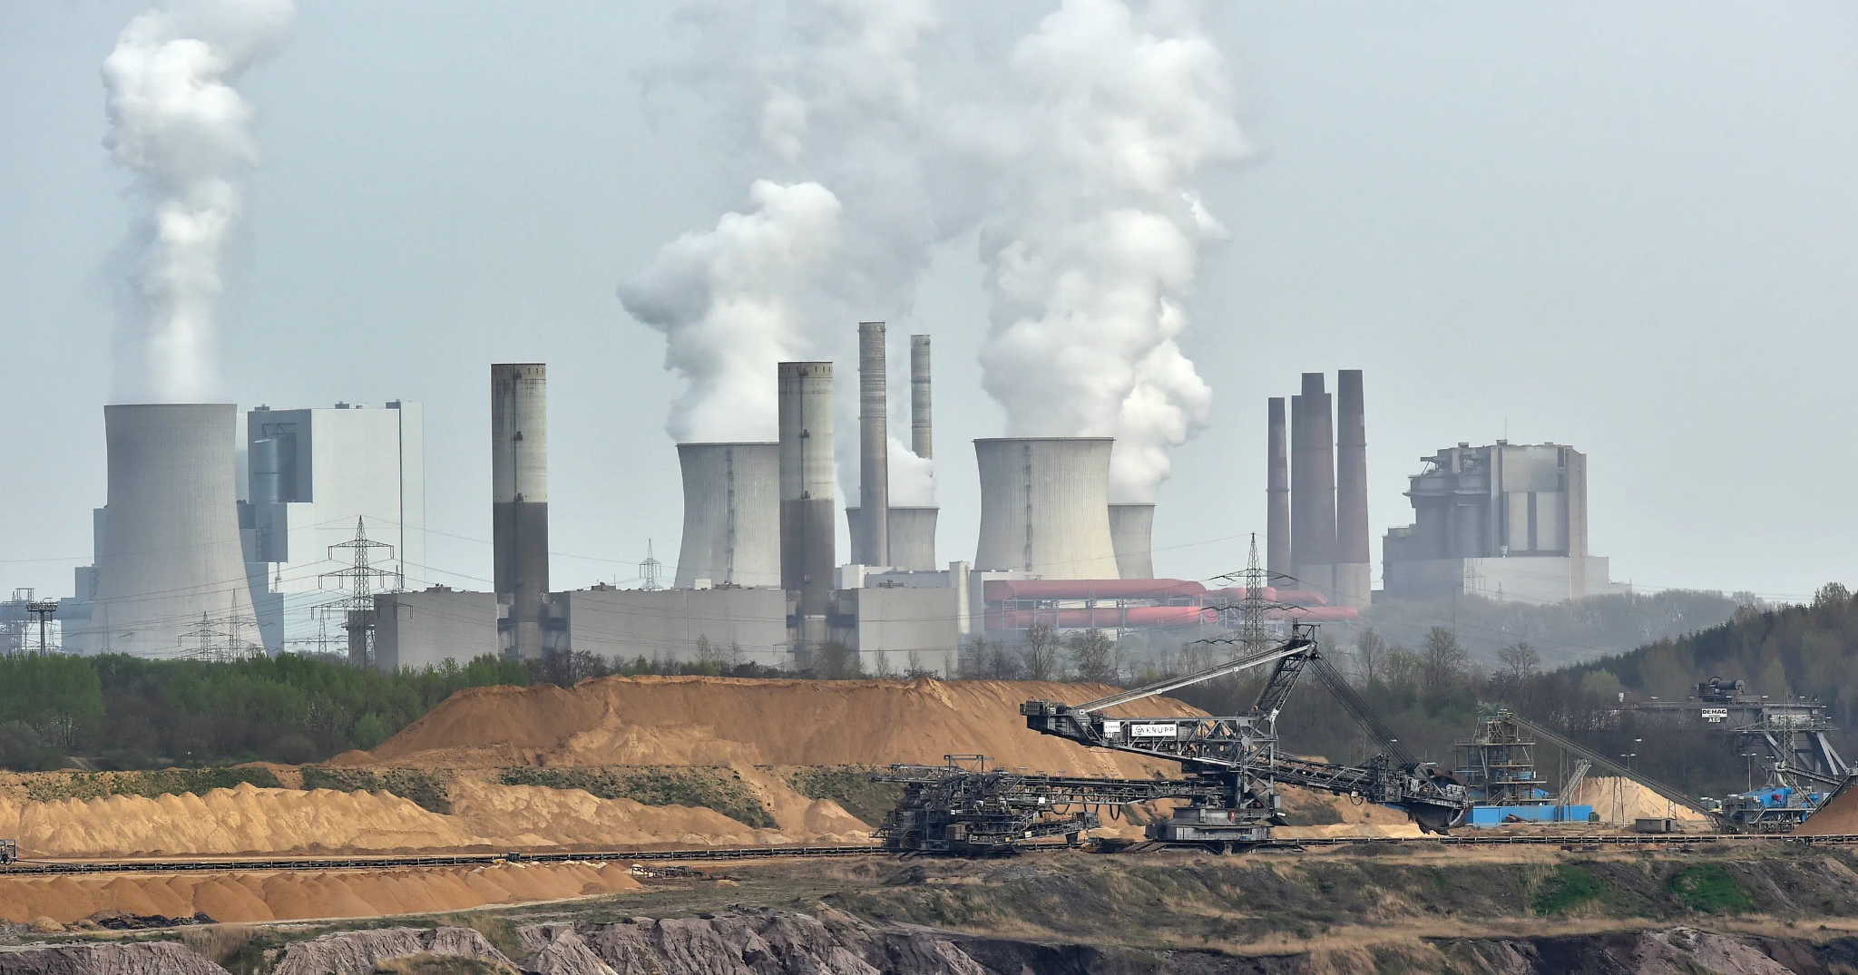
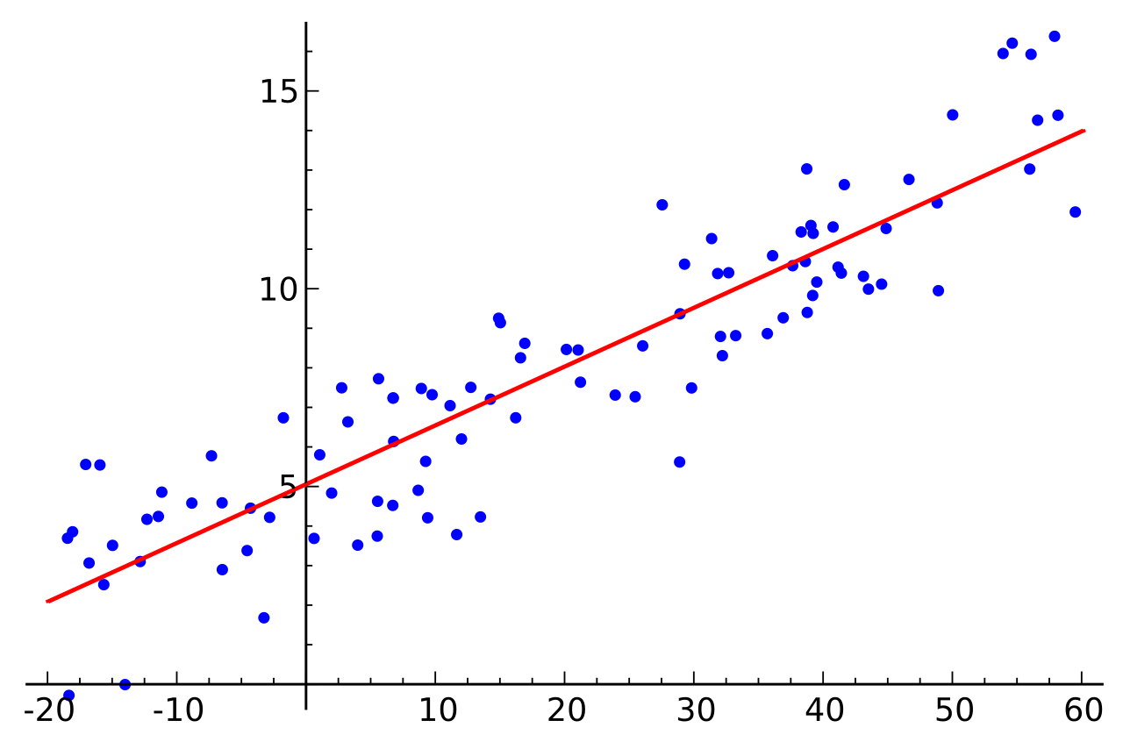
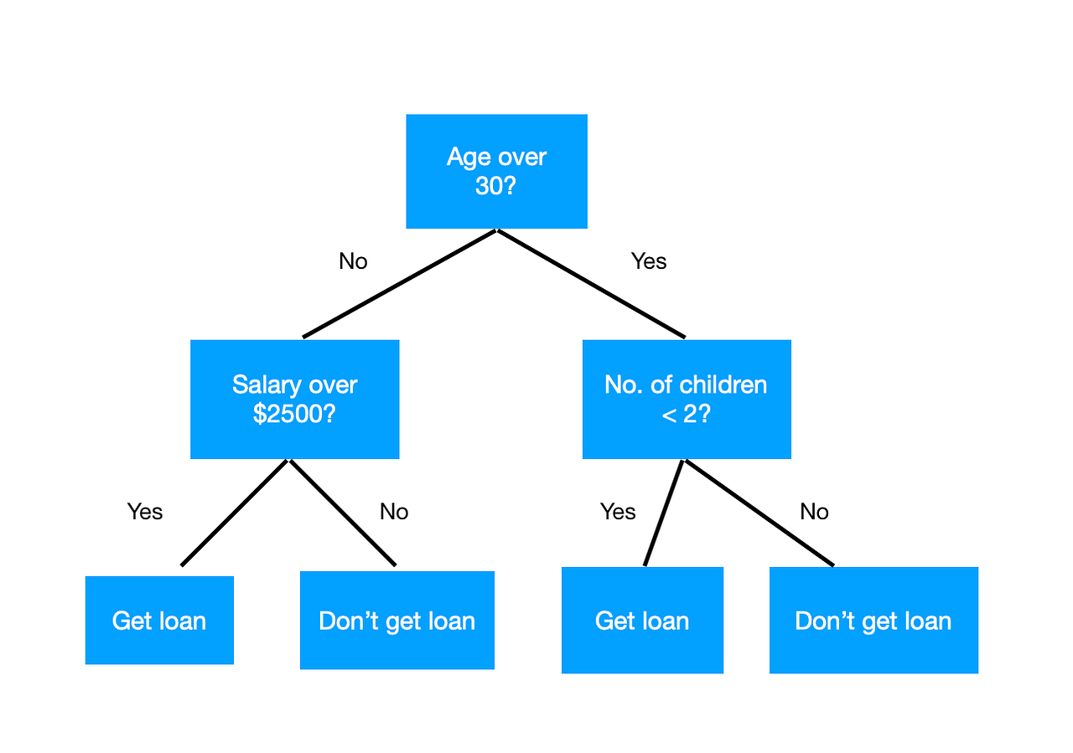

Goals
Notes:
We wanted to find the top emissions producers
Run regressions on approximately the last 20 years of their emissions production
Predict to 2040 and compare different regressions algorithms
Make a useable, interactive dashboard to display the information
Build a decision tree model to classify developing vs developed countries.

Slide 4
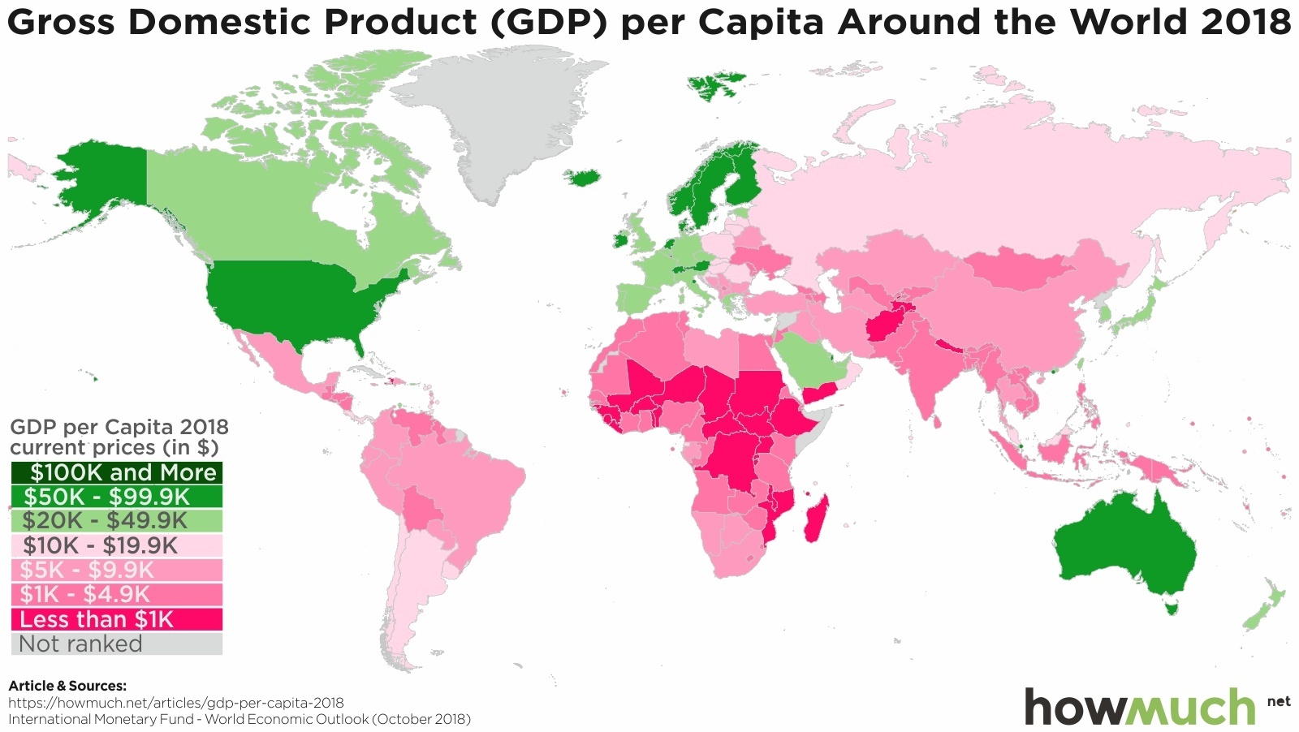

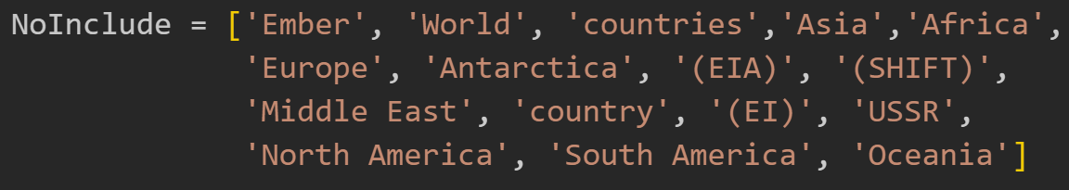
Preprocessing
Regression Dataset -
Emissions over time
Developed vs Developing - consumption
Developed vs Developing - electricity
https://datahelpdesk.worldbank.org/knowledgebase/articles/906519
Notes:
Remove any countries from the dataset that contain these keywords anywhere in their name
Calculate GDP per capita using available GDP and population data
Establish a country’s status as ‘developed’ or ‘developing’ based on GDP per capita threshold from World bank, high-income economies are those with a GNI per capita of $13,846 or more. - from https://datahelpdesk.worldbank.org/knowledgebase/articles/906519
Select only the carbon emissions, year and country columns for one dataset – regression
Select only energy consumption (columns that contain ‘_consumption’) (734 consumption datapoints)
Select electricity columns (columns that contain ‘_electricity’)
Remove all rows that do not contain information (4428 datapoints for electricity datapoints)

Slide 5
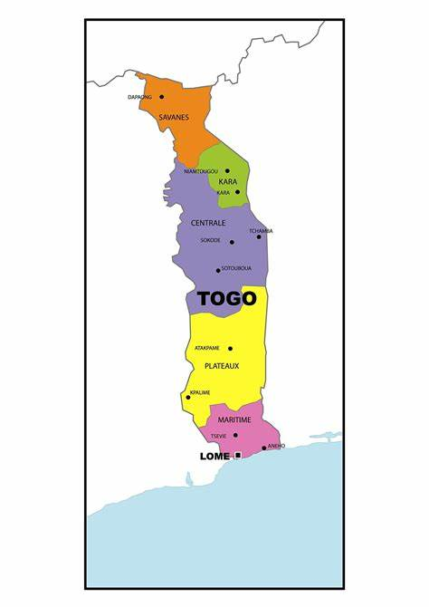
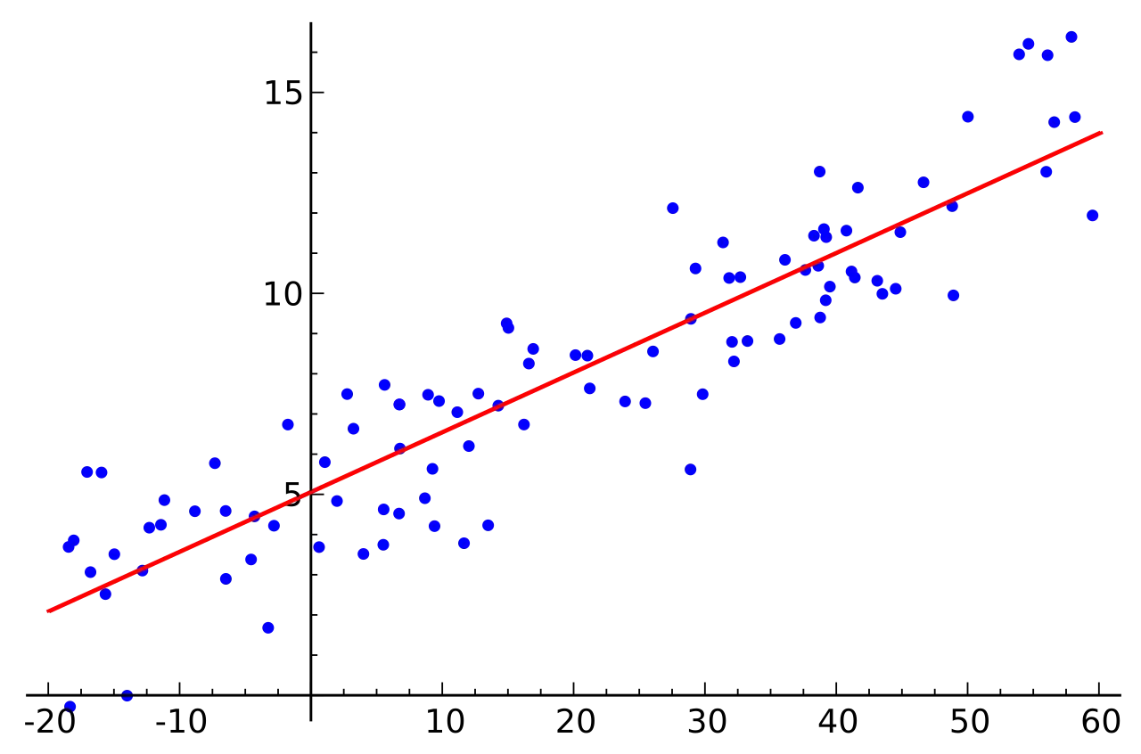
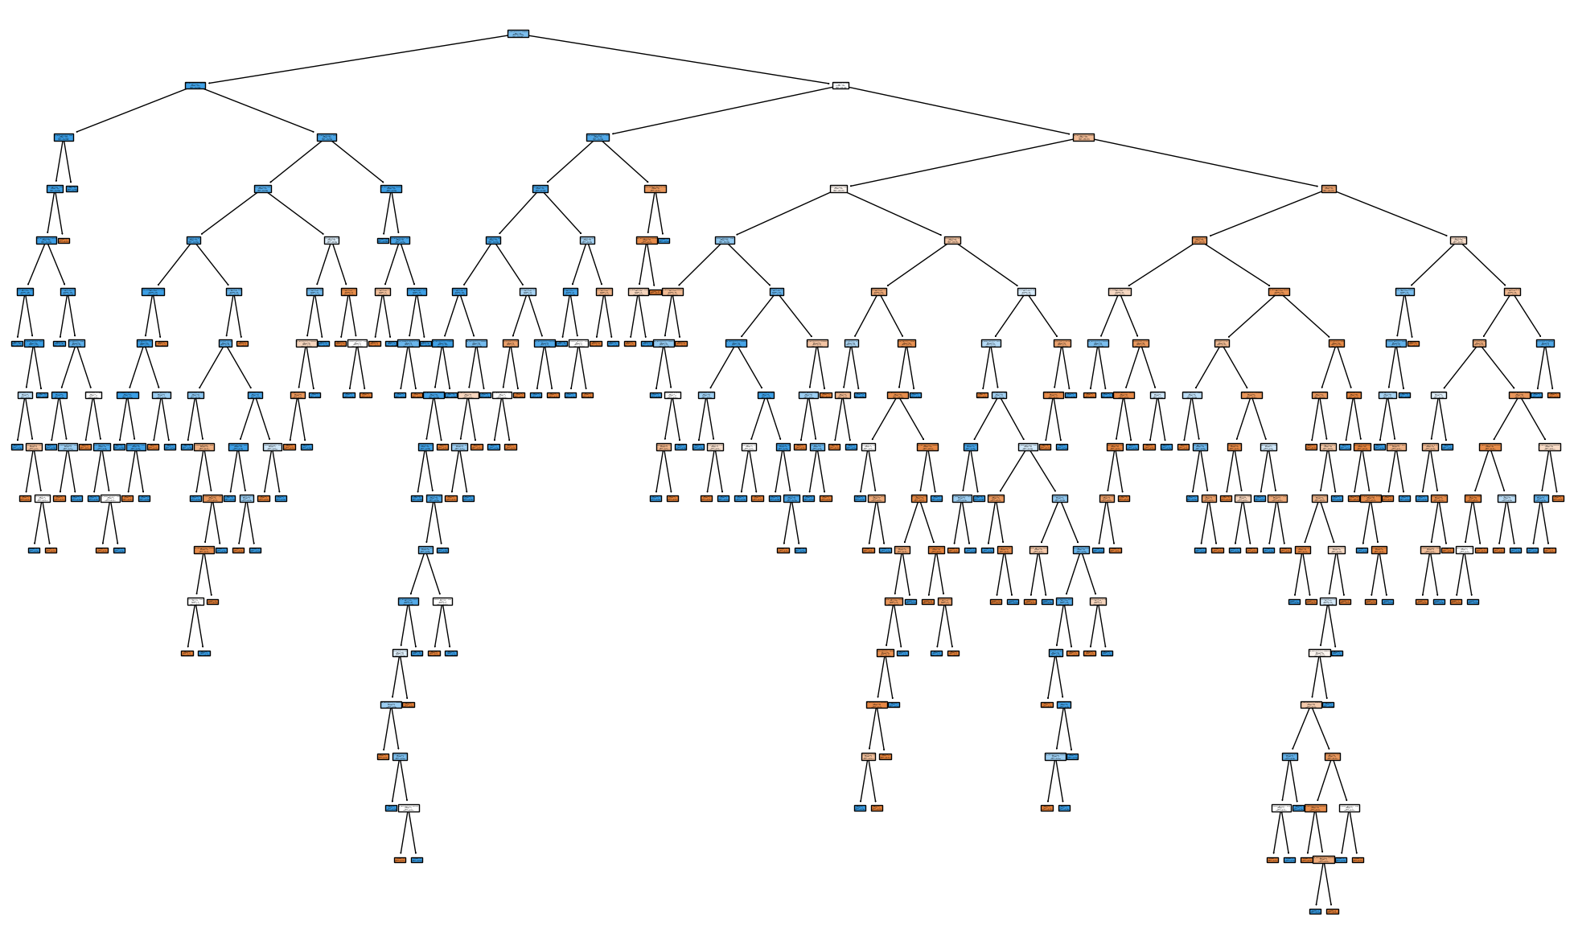
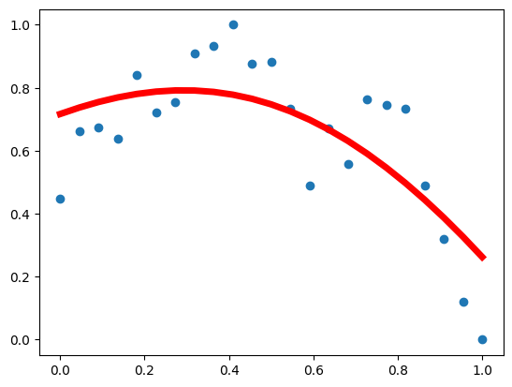
Building Models
86.4%
Linear
Quadratic
Cubic
Quartic
92.3%
Pytorch Regression NN
Electricity Production Based Decision Tree
Notes:
For each country, calculate a linear regression, quadratic regression, cubic regression & quartic regression
Use NN to do another regression
Pytorch Regression NN
-1 hidden layer, 10 nodes,
-0.1 learning rate
-600 epochs
-Min-Max normalized inputs
Use R2 score to determine the best model for fitting to the prior data & use regression algorithms to predict until 2040. Store all data in .csv for tableau.
Used fuel consumption data and electricity product data to build a highly accurate decision trees - 86.4% consumption, 92.3% electricity

Slide 6
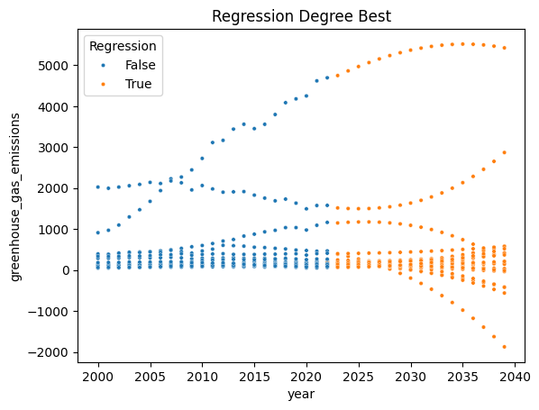
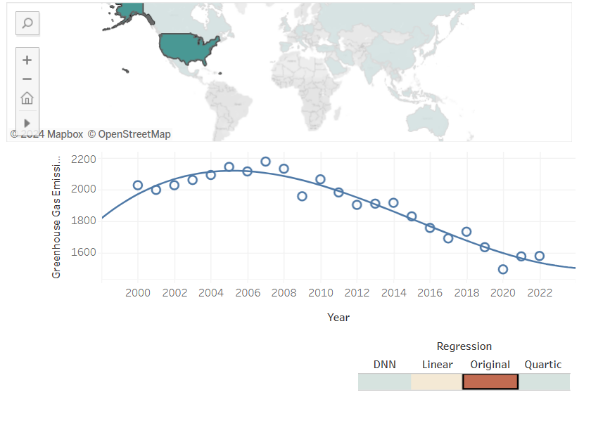
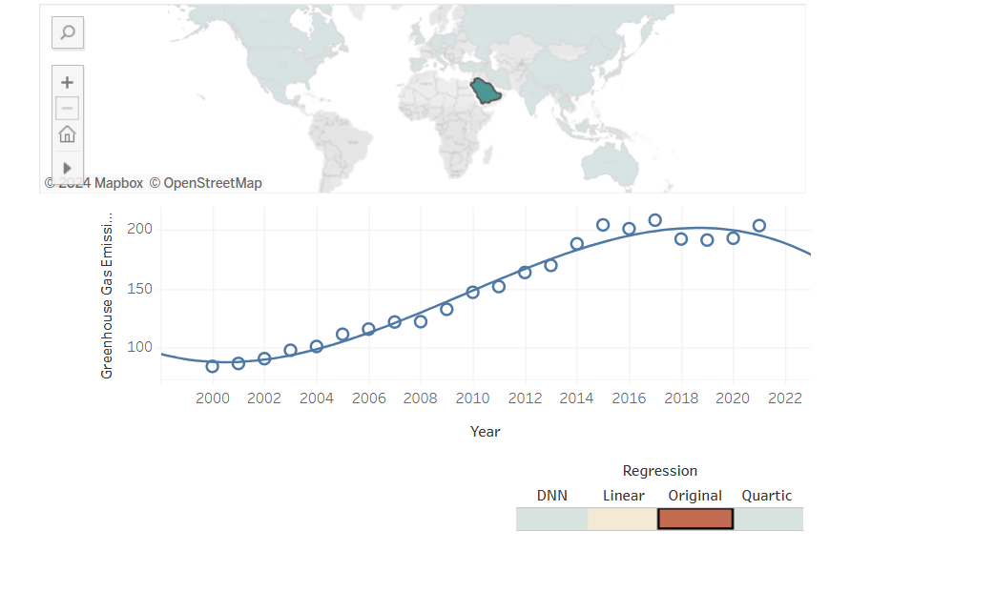
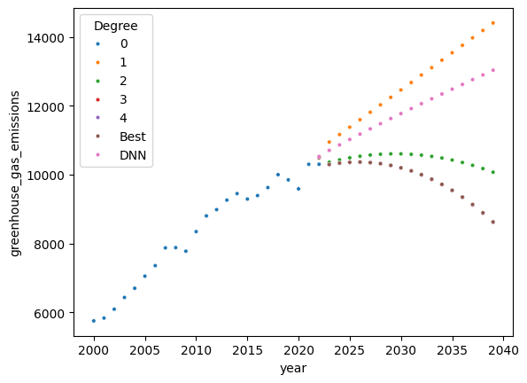
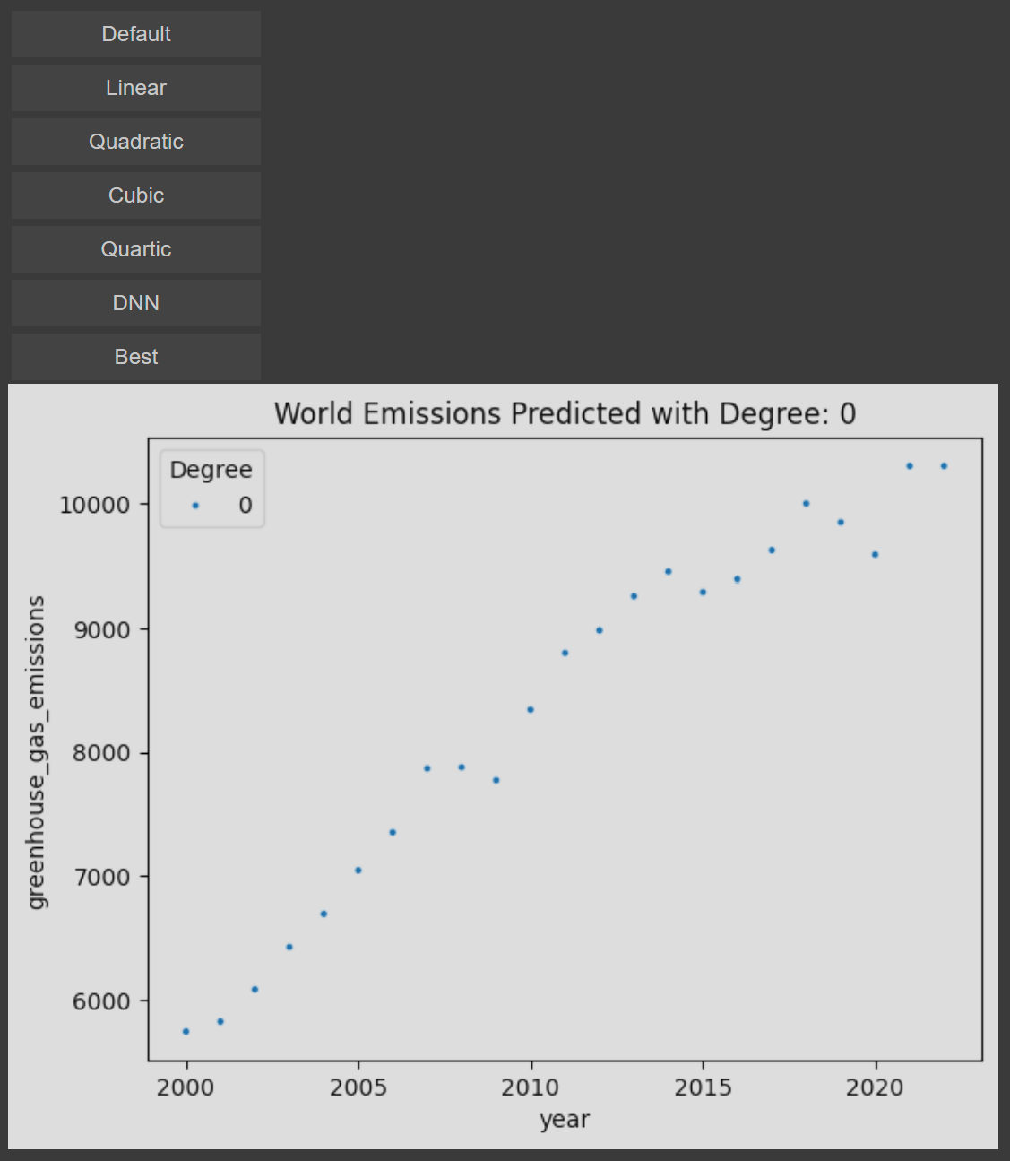
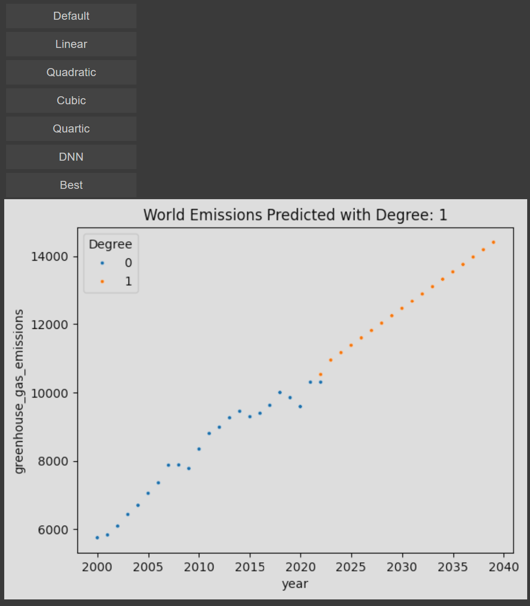
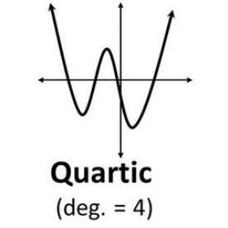
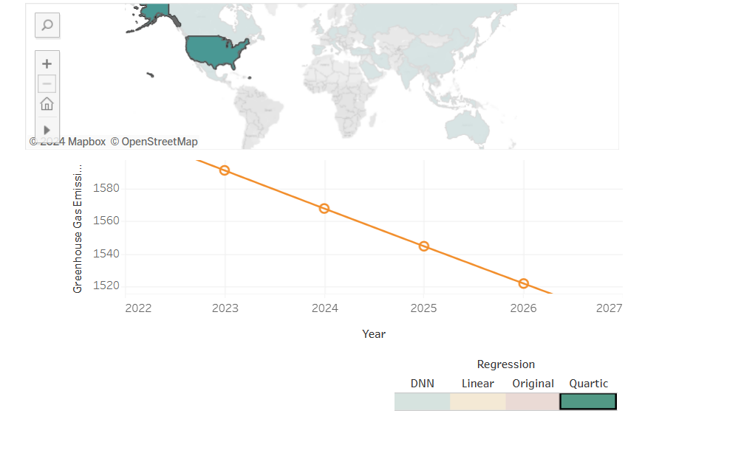
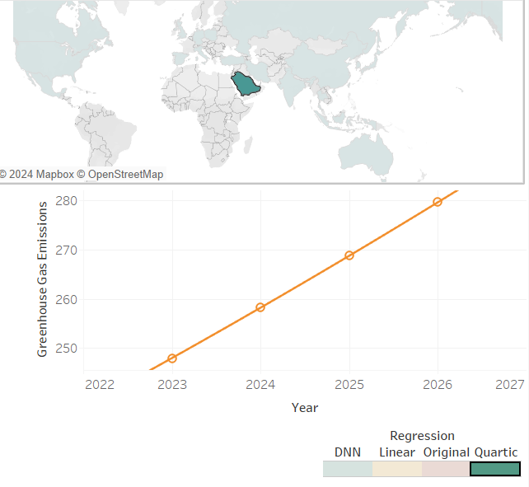
Regression Insights
Sum of Top 20 Emitters Emissions
Projected emissions 2022-2040
Quartic has lowest RMSE
Built a Tool with Bokeh to choose and plot regression algorithm for sum of Top 20 Countries
Plotted the best regressions based on R2 Score

Slide 7

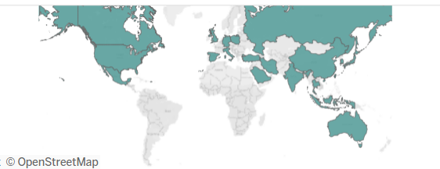

Tableau Dashboard
Link to Tableau

Slide 8
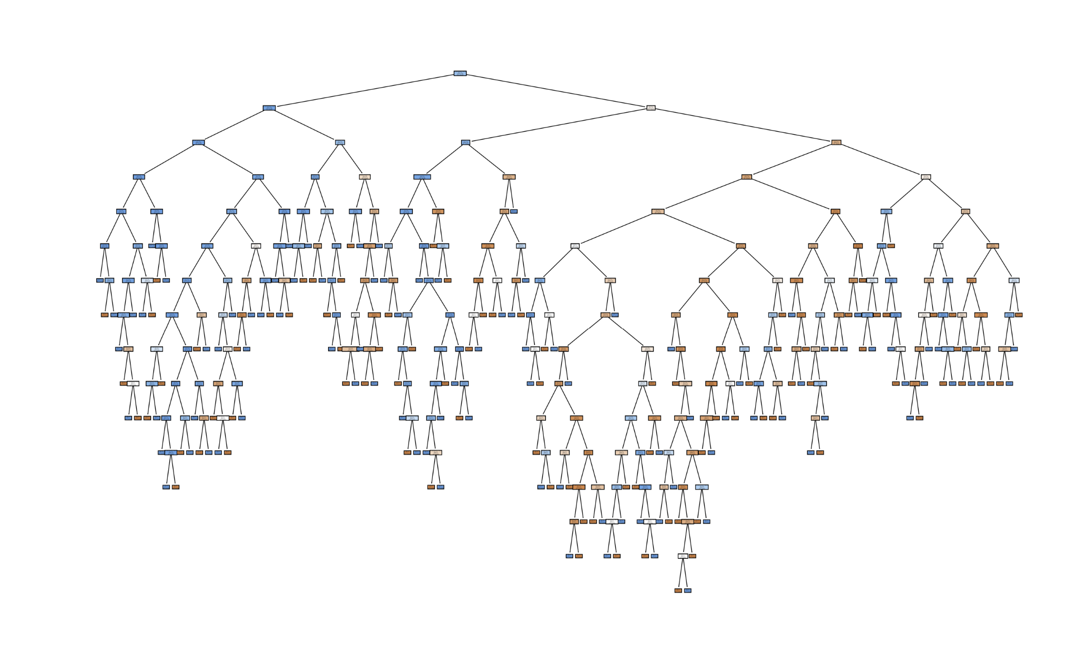
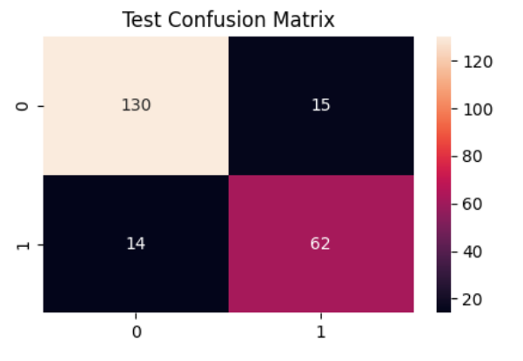
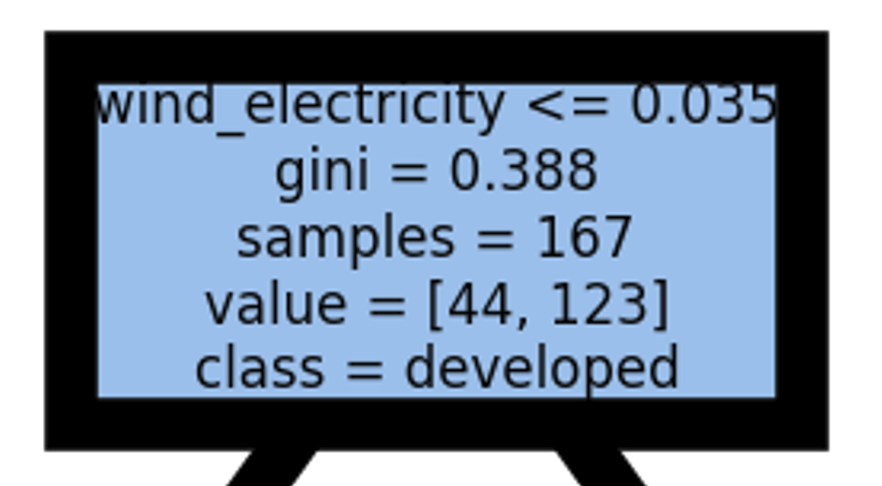
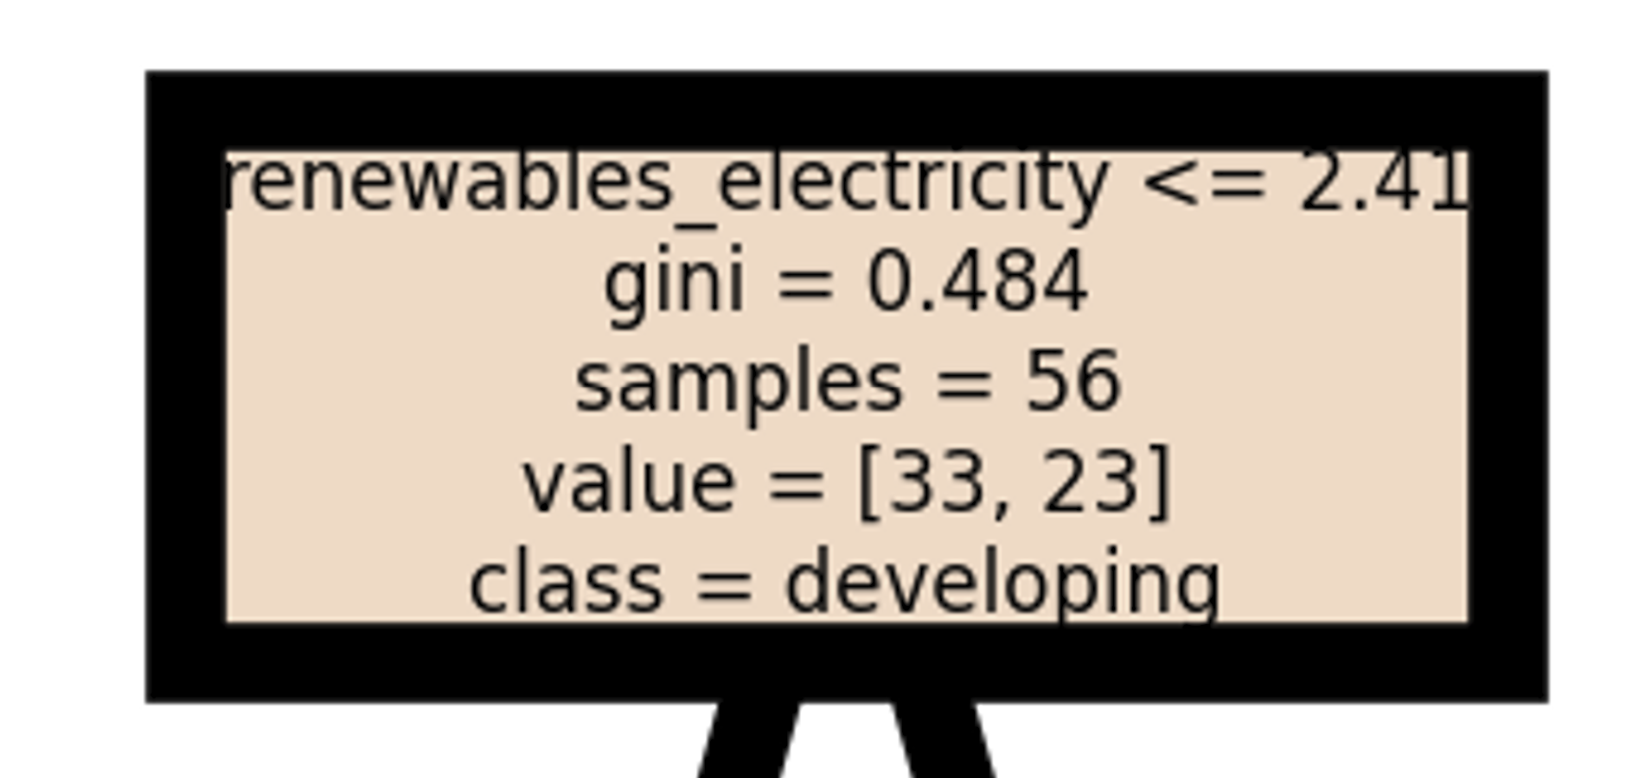
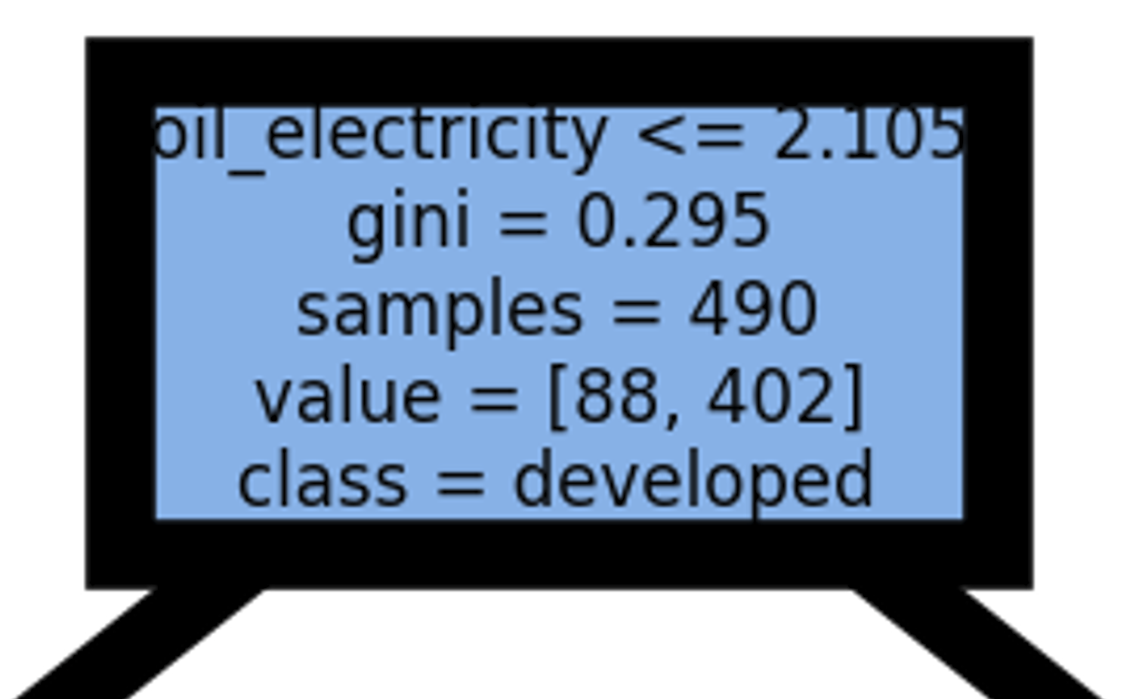
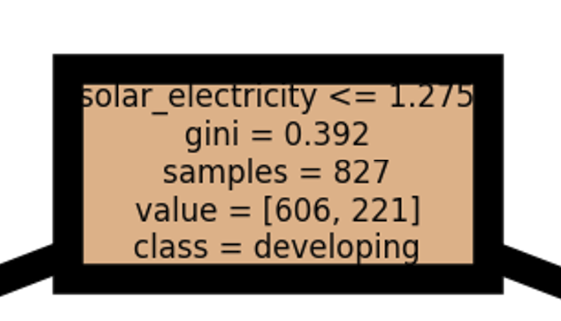
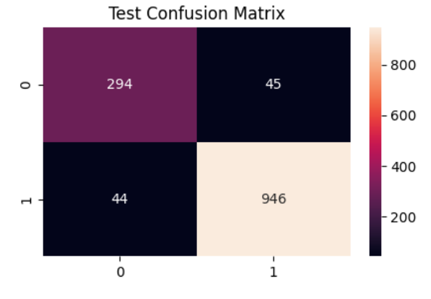
Classification Insights
Fuels Consumed--86.4%
Electricity Produced--92.3%
Electricity Produced Decision Tree

Slide 9
Thank You!
Questions?

Slide 10
Images
The Evolution of Kaggle - Business Forecasting (businessforecastblog.com)
https://th.bing.com/th/id/R.bacad16603d10ba34ec019362c0842a3?rik=1zLuOO8OsNNnxw&riu=http%3a%2f%2falabamamaps.ua.edu%2fcontemporarymaps%2fworld%2fworld%2fthumbs%2fworld3c.jpg&ehk=H1Y4p1%2f1kse30k5c8KjE%2fWqIOFAul1XEZrH4RaXsQeE%3d&risl=&pid=ImgRaw&r=0
Global carbon dioxide levels at record high in 2013 (usatoday.com)
Simple Linear Regression - Introduction to Regression Analysis (datasciencelk.com)
How to Create Interactive Tools That Captivate Your Audience (contently.com)
Decision Trees: Explained in Simple Steps | by Manav | Analytics Vidhya | Medium
Visualizing GDP per Capita by Country (howmuch.net)
HR Analytics using MS Excel (Excel Analytics) (youtube.com)
Togo Maps & Facts - World Atlas

